Slide 1
The
Health Care Law and You
Date:
Presented By:
Contact Info:
Notes:
Hello, my name is XXX. And I’m glad to be with you today to talk about the health care law – the Affordable Care Act – and what it means for you, your family, and your community.

Slide 2
The Problem
American Indians and Alaska Natives face some of the worst health disparities.
Insurance companies could take advantage of you and discriminate against up to 129 million Americans with pre-existing conditions.
Premiums had more than doubled over the last decade, while insurance company profits were soaring.
Fifty million Americans were uninsured, tens of millions more were underinsured, and those that had coverage were often afraid of losing it.
Notes:
The first question most people have is: why did we need the health care law?
The answer for Indian Country was seen in the health disparities faced by American Indians and Alaska Natives, including rates of heart disease, obesity, and diabetes. American Indians and Alaska Natives born today have a life expectancy that is about 5 years less than that of the general population. When it came to health care services, IHS was struggling to fully meet the needs of Indian Country, and contract health dollars were running out too soon. And some American Indians and Alaska Natives wanted to purchase health insurance; however, they faced the same challenges as the rest of the country.
By paying for an insurance policy, we can ensure that money is available to pay for the health care benefits we need to lead the healthiest life possible.
But prior to the health care law, we had a health insurance market that worked very well for big insurance companies, but not so well for American families.
Insurers could pick and choose who they gave coverage to, and premiums were skyrocketing even as insurers made record profits. That made it hard for families to get the security that health insurance provides.
In total, fifty million Americans were uninsured and tens of millions more had coverage that didn’t cover critical treatments and preventive care. And many of us who had insurance didn’t understand the basics of our plan and were afraid we could lose it if our employer dropped coverage or we switched jobs or retired.
This left many Americans feeling like their health care choices were out of their hands.

Slide 3
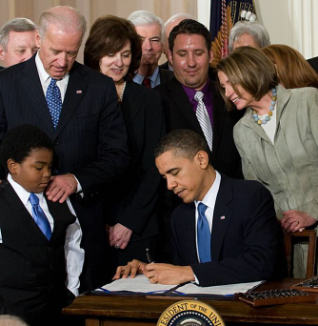
The Health Care Law
In March 2010, President Obama signed into law the
Affordable Care Act.
The law included a permanent reauthorization of the
Indian Health Care Improvement Act.
Notes:
That’s why Congress passed and the President signed the Affordable Care Act, which also includes the permanent reauthorization of the Indian Health Care Improvement Act.

Slide 4

The Affordable Care Act benefits American Indians and Alaska Natives
Permanent Reauthorization of the Indian Health Care Improvement Act
Strengthening the Indian Health Service
Greater Access to Health Insurance Coverage
Notes:
And the health care law makes special improvements for the health of those in Indian Country.
The law includes the permanent reauthorization of the Indian Health Care Improvement Act, a critical piece of legislation for the health care system used by many American Indians and Alaska Natives.
The law makes sure the Indian Health Service is here to stay and makes improvements for its future.
And finally, the law offers American Indians and Alaska Natives more options for health insurance.
Today, we’ll talk a bit more about these areas and how the law impacts the health of Indian Country and all Americans.

Slide 5
Health Care and
Federal Responsibility
  The government’s historical and unique legal relationship with Indian Tribes is based on treaties, laws, and Supreme Court decisions.
    Indian Health Service offers health care to AI/ANs on or near Indian reservations and in some urban Indian communities.
    Health reform offers new opportunities to access health insurance to AI/AN citizens and employees.
Notes:
The federal government has a longstanding commitment to American Indians and Alaska Natives and honors the government-to-government relationship between the United States and Tribes across the country. This trust responsibility is based on treaties, laws, and Supreme Court decisions.
A part of this responsibility is the availability of the Indian Health Service, but an extension of that responsibility is the new opportunity to make quality health care more available through the new benefits of the Affordable Care Act.

Slide 6
Listening to Indian Country:
Tribal Consultation
Critical component of a productive federal-tribal relationship.
Consultation and outreach efforts continue to provide more education and information about the new law, plans for its implementation, and how it will impact Indian Country.
Activities include written and electronic communication, monthly outreach calls, and listening sessions.
IHS Director’s blog, a key source of information for Tribes: www.ihs.gov/PublicAffairs/DirCorner
Notes:
As we implement the health care law, we are listening to Indian Country.
We take seriously the federal government’s obligation to help improve the health of American Indians and Alaska Natives through the various health and human services programs administered by HHS.
However, improving the health and well-being of tribal nations is contingent upon understanding the specific needs of tribal communities. Tribal consultation is an essential tool in understanding these unique needs and ensuring government-to-government relations.
As implementation moves forward, we know Indian Country is joining us every step of the way. For example, IHS is partnering with national and regional Indian organizations to do outreach and education on the health care law. This outreach and education will include information on the American Indian and Alaska Native special provisions to make sure you have the information you need.

Slide 7

Indian Health Care Improvement Act
The permanent reauthorization of the IHCIA is a critical piece of the Affordable Care Act.
Tribes fought for more than a decade to reauthorize and update the IHCIA. Prior reauthorization of the law occurred in 1997.
Reauthorization provided important updates to IHS.
Notes:
An important component of the health care law is that it permanently reauthorized the Indian Health Care Improvement Act, which was first enacted into law in 1976. Since 1976, it was reauthorized in 1980, 1988, and 2000.
For ten years, Indian Country fought to reauthorize the Indian Health Care Improvement Act in order to modernize the IHS and ensure that necessary changes to the legislation were made in order to best meet the needs of Indian Country.
Because of the health care law, the Indian Health Care Improvement Act was permanently reauthorized. This reauthorization also makes the IHS permanent and allows IHS to update its services in order to improve the delivery of health care to many in Indian Country.

Slide 8
Strengthening the Indian Health Service
Expanded Authority for IHS services: Mental and behavioral health treatment and prevention, long-term care services, dialysis services, facilitation of care for Indian veterans, and urban Indian health programs.
Greater Workforce: Increasing clinician recruitment and retention in tribally-operated health programs
Expanded Third-Party Funding: Medicare, Medicaid, the Children’s Health Insurance Program (CHIP), and private insurance-covered populations will increase payments to IHS to support both direct care and contract health care services. This will free up IHS funds for expanded offerings.
Notes:
The Indian Health Care Improvement Act reauthorization helps with:
Expanded Authority for IHS services: This includes mental and behavioral health treatment and prevention, long-term care services, dialysis services, facilitation of care for Indian veterans, and urban Indian health programs.
Greater Workforce: Through increasing clinician recruitment and retention in tribally-operated health programs
Expanded Third-Party Funding: Reimbursements from Medicare, Medicaid, the Children’s Health Insurance Program, and private insurance for covered populations will increase payments to IHS to support both direct care and contract health care services. This will free up IHS funds for expanded offerings. More opportunities for coverage will mean more resources in Indian Country.

Slide 9

Contract Health Services
Before the law, contract health dollars ran out too soon.
Now, with additional options for health insurance, more contract health dollars will be available to meet the health care needs of Indian Country.
Notes:
Contract Health Services are a part of Indian Country.
Prior to the Affordable Care Act, contract health dollars ran out quickly for American Indians and Alaska Natives, who often had no insurance coverage.
With more of the community covered with some form of health insurance, contract health dollars will be available to care for the most vulnerable in the Indian Country.
Insurance coverage allows Indian Country to have resources to access the important healthcare services it needs. But for those in Indian Country who cannot afford health insurance, there will be more contract health dollars available for the services they need, and the entire community will benefit.

Slide 10

Giving Indian Country More Choices for Health Care
  In addition to IHS, choices for health care coverage include:
    Greater Access to Medicaid
    Private Insurance through the Affordable Insurance Exchanges
    Access to the Federal Employees Health Benefits program for tribal employees
    Offering more options for health care is an extension of the U.S. Government’s Trust Responsibility
Notes:
The Affordable Care Act benefits American Indians and Alaska Natives because they will have more choices for their healthcare:
If they have access, they can still go to IHS because the law makes IHS permanent.
If they want to enroll in Medicaid, more people will qualify based on income.
If they want to purchase health insurance, it will be more affordable and prices will be lower because of new Affordable Insurance Exchanges.
If they work for a tribe or tribal program, they may have access to the Federal Employees Health Benefits program.
If more IHS patients have insurance or Medicaid coverage and still get their care at IHS, IHS will have more funds to expand services for everyone.
Let’s talk a bit more about these areas.

Slide 11
Giving Indian Country More Choices for Health Care: Medicaid
Today, the median income of American Indian and Alaska Native households is $35,000. This compares with $50,000 for the nation as a whole.
Starting in 2014, more AI/ANs will qualify for Medicaid based on income alone.
No premiums or deductibles for AI/ANs who are eligible to receive IHS or tribal 638 services, and no copays for services received from an Indian health care provider or through referral under contract health services.
Notes:
Beginning in 2014, there will be better access to Medicaid for Americans.
Eligibility for Medicaid will only consider income, not conditions. And, for the first time ever, single, childless adults will qualify for Medicaid.
You will be able to enroll in Medicaid if your income is at or below about $30,000 for a family of four or $37,000 in Alaska.
And we will continue to have important protections for Medicaid income eligibility in place for American Indians and Alaska Natives.
Source: American Indians: Census Facts — Infoplease.com http://www.infoplease.com/spot/aihmcensus1.html#ixzz1oGfXAayy

Slide 12

Giving Indian Country More Choices for Health Care: Insurance Exchanges
Your insurance premiums will cost less if you have an income up to $89,000 for a family of four or $112,000 in Alaska.
No out-of-pocket costs (copays or deductibles) if you choose IHS as your provider in your insurance network.
No out-of-pocket costs with any health care provider if your income is under $67,000 for a family of four.
Notes:
But Medicaid is only one option for health insurance coverage. The Insurance Exchanges will offer Indian Country even more options for those who want to purchase coverage.
First, let’s be clear. There is no penalty if an American Indian or Alaska Native decides to not purchase insurance coverage. But if you do decide to purchase insurance through the Exchange, there are important benefits for you:
Your insurance premiums will cost less if you have an income up to $89,000 for a family of four, or $112,000 in Alaska;
No out-of- pocket costs (copays or deductibles) if you use IHS with your insurance);
No out-of- pocket costs with any health care provider if your income is under $67,000 for a family of four.

Slide 13
Giving Indian Country More Choices for Health Care: Federal Employees Health Benefits Program
Who Can Access FEHB:
  Indian Tribes, tribal organizations, and urban Indian organizations that decide to purchase health insurance for their employees
How FEHB Works:
  Tribes pay the employer portion of premiums, including an administrative fee to cover operating expenses;
  Tribes assist with employee premium collection (payroll deductions);
  Employee contributions/payments for health insurance may be lower and coverage may be better/more comprehensive.
Additional coverage options mean more contract health dollars for the community are made available.
Notes:
Another coverage option for tribal employees is the Federal Employees Health Benefits program.
The program gives Indian Country access to a robust group of health insurance plans that today cover about 8 million federal civilian employees, retirees, former employees, family members, and former spouses. Tribes now have the choice to purchase health insurance with potentially better coverage for their employees.
The Office of Personnel Management began enrolling tribal employers in Spring of 2012.

Slide 14

What the Law Means for All Americans:
Four Things to Know
Protects all Americans from the worst insurance company abuses
Makes health care more affordable
Improves access to care
Strengthens Medicare
Notes:
And there is more.
As you see from the improvements we will make in Indian Country, the health care law builds on what works in our health care system. But it also fixes what’s broken by making improvements in four key areas:
It protects you from the worst insurance company abuses;
It makes health care more affordable. It gives you better access to care; and
It strengthens Medicare.
Let’s talk a little more about each of these areas.

Slide 15
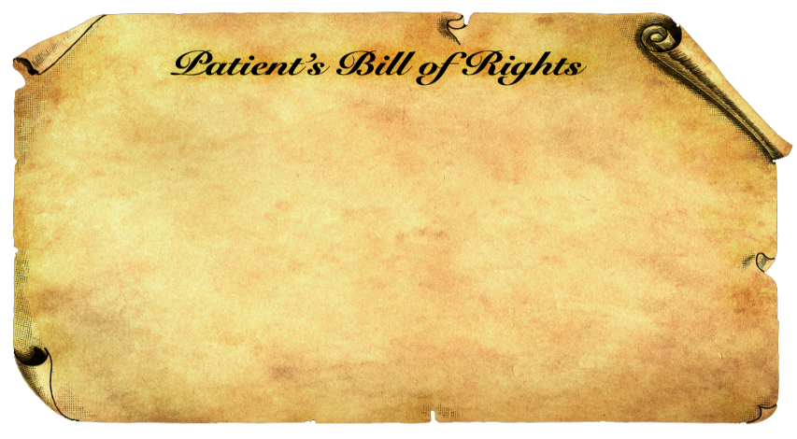
The Law Stops Insurance Companies
From Taking Advantage of You
It is now illegal for insurance companies to:
Deny coverage to children because of a pre-existing condition like asthma and diabetes.
Put a lifetime cap on how much care they will pay for if you get sick.
Cancel your coverage when you get sick.
And more . . .
Notes:
In the past, insurance companies could take advantage of you. They could deny coverage to children who had asthma or were born with a heart defect. These are the young people who need health insurance the most, and insurers were free to turn them away.
They could also put a lifetime dollar cap on the amount of care they would pay for. So if you developed a serious condition like cancer or a rare blood disease, or you were injured in a car crash, your insurance could disappear when you needed it most.
And worst of all, they could cancel your coverage when you got sick just by finding an accidental mistake in your paperwork. Some insurance companies even used computer programs designed to search the records of people with breast cancer or HIV looking for these errors.
The first main way the law helps you is by creating a new Patient’s Bill of Rights that protects you from these and other abusive practices.
[FOR THE SPEAKER’S REFERENCE: Other consumer protections in law include:
-Annual limits to coverage are being phased out and will be banned in 2014.
-You have access to an independent appeals process if you are in a dispute with your insurance company.*
-Insurers can’t charge an extra co-pay if you go to an out-of-network emergency room.*
-You can choose your own primary care physician in your insurers network, and you can see a pediatrician or an OB-GYN without a referral.*
*--non-grandfathered plans]

Slide 16


The Law Makes Health Insurance More Affordable
BEFORE, insurance companies spent as much as 40 cents of every premium dollar on overhead, marketing, and CEO salaries.
TODAY, we have the new 80/20 rule: in most states, insurance companies must spend at least 80 cents of your premium dollar on your health care or improvements to care.
If they don’t, you get money back.
60% / 40%
80% / 20%
Notes:
The second way the law helps you is by bringing down health care costs and making sure your health care dollars are spent wisely. Some private insurance companies spent almost half your premium on overhead like marketing and CEO salaries, leaving only 60 cents of every premium dollar to spend on care.
The health care law ensures that you get a fair value for your premium by creating the new 80/20 rule: insurers must now spend at least 80 percent of your premium on health care services or improving care or they have to give you money back.

Slide 17

The Law Makes Health Insurance More Affordable
BEFORE, insurance companies could raise your premiums by double digits without justification.
TODAY, insurance companies must publicly justify their actions if they want to raise premiums by 10 percent or more. And more states are choosing to block them.
Notes:
We also know that over the last decade, premiums have grown three times faster than wages. That’s why the health care law has new rules that require insurance companies - for the first time ever - to publicly justify any rate increase of 10 percent or more. And it gives states new resources to review and block these premium hikes. The days of insurance companies hiking your rates without justification are over.

Slide 18
The Law Increases Your Access to Affordable Care
Young adults under the age of 26 can now stay on their parents’ health plans.
“I honestly don’t know what we would have done. . . . There was no way we could have afforded it. I might not be here right now.”
--Kylie L., 23, in Illinois, who credits the health care law for enabling a life-saving heart transplant
Notes:
The third key part of the law is a set of improvements that increase your access to affordable care. For years, young adults have had some of the highest rates of being uninsured.
Most young people lost their family coverage when they graduated high school or college, and it was often a few years before they got a job that offered good health coverage. Even then, they could lose their coverage if they lost their job. That meant that if they had a car accident or an unexpected diagnosis during this period, they could go broke or their families could go broke – or worse, they might not be able to afford the care they needed.
Now, under the law, young adults who don’t get coverage through their jobs can stay on their parents’ plans until age 26 – a change that has already allowed one million young adults to get health coverage and given their families peace of mind.

Slide 19


The Law Increases Your Access to Affordable Care
Insurance companies must now pay the cost of many preventive services:
Cancer screenings such as mammograms & colonoscopies
Vaccinations such as flu, mumps & measles
Blood pressure screening
Cholesterol screening
Tobacco cessation counseling and interventions
Birth control
Depression screening
And more…
Visit www.healthcare.gov/prevention for a full list.
Notes:
The law is also expanding access to preventive care. We know that getting the right preventive care like cancer screenings and vaccines is one of the best ways to stay healthy. But too many Americans went without this care because it often required expensive co-pays. When the choice was $50 for a mammogram or $50 for groceries, too many people had to take their chances.
Now, they don’t have to make that decision. Thanks to the health care law, the healthy choice is the easy and affordable choice. In new plans, a wide range of recommended preventive services are available for free, and insurance companies will have to pay for these services. That won’t just help people stay healthy. It will also help avoid costly hospitalizations that raise insurance costs for all of us.

Slide 20

The Law Increases Your Access to Affordable Care
There are new plans in every state for people who have been locked out of the insurance market because of a pre-existing condition like cancer or heart disease.
    “When I was diagnosed, they told me I had a 60 percent chance of being cured. That's pretty good odds, but I was also terribly worried about finances. Now I don't feel like we can't afford the treatment."
    --Gail O. in New Hampshire
For more, visit www.PCIP.gov.
Notes:
Under the old system, no one got a worse deal than the 129 million Americans with pre-existing conditions. When buying coverage on their own, insurance companies could hike their rates, carve out needed benefits, and in many cases, lock them out of the insurance market altogether. For people with potentially fatal conditions like cancer, this often meant they couldn’t afford the treatments that could save their lives.
The health care law has given Americans who’ve been locked out of the market for their pre-existing conditions a new coverage option. As a result, tens of thousands of Americans with serious health conditions across the country are now getting the health insurance they need.

Slide 21
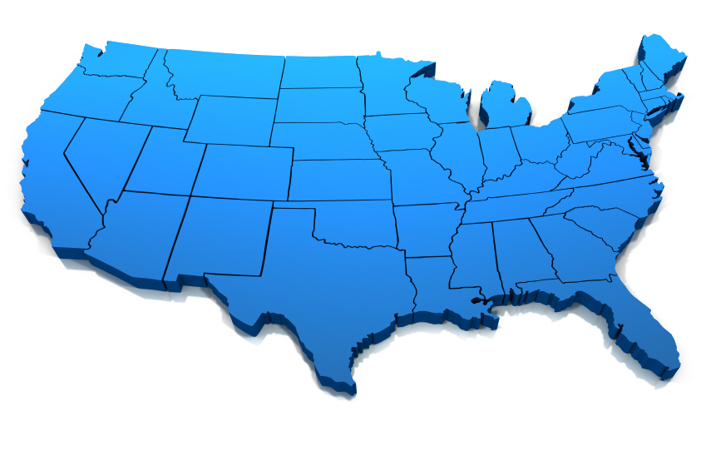

The Law Increases Your Access to Affordable Care
There are thousands of new doctors and nurses in communities around the country and millions more patients getting care.
Notes:
But we all know that health insurance wasn’t the only obstacle to care. Too often, you’d call up your doctor and hear that the next appointment was in 4 months. Or you’d only see your doctor for 10 minutes because they had to rush on to their next patient.
That’s why the health care law also invests in training and placing thousands of new doctors and nurses, and it provides bonus payments to primary care doctors.
There is a big investment in growing the National Health Service Corps. The Corps is a program that awards scholarships and loan repayment to primary care providers who commit to serving for at least 2 years in Health Professional Shortage Areas. Many choose to continue serving at their sites beyond the initial service commitment.
With support from the Indian Health Service and Secretary Sebelius, HRSA and IHS have designated all IHS and tribal facilities as National Health Service Corps approved sites. This allows these facilities to recruit and retain primary care providers by utilizing the scholarship and loan repayment incentives offered through the National Health Service Corps program.
In fiscal year 2011, there were 224 National Health Service Corps clinicians in Indian Country.
And the law is also creating and expanding health centers across the country. This will help you see and spend more time with your doctor.

Slide 22

The Law Strengthens Medicare
Free preventive services such as mammograms and colonoscopies and a free annual wellness visit with your doctor.
A 50% discount on brand-name medications for those in the prescription drug donut hole – an average savings of nearly $600 per person in 2011. The donut hole will be closed in 2020.
Strong anti-fraud measures, including tougher penalties for criminals.
Tools to help doctors spend more time
with elders and improve care coordination –
just like they do at leading hospitals such as
the Mayo Clinic and Cleveland Clinic.
Notes:
And it is also important to improve Medicare, a program that is especially important for many elders in Indian Country.
Nearly 50 million seniors and Americans with disabilities depend on Medicare every day. And the health care law makes Medicare even stronger by making several key improvements:
First, it makes many key preventive services available with no co-pay or deductible to help ensure that no elder ever has to skip a potentially life-saving cancer screening because they can’t afford it.
Second, the law provides relief to people in the Medicare Part D prescription drug coverage gap – known as the “donut hole.” Before the law, under Medicare Part D, seniors in the donut hole had to cover out-of-pocket all prescription drug costs between about $2700 and $6100. The law gives those in the donut hole a 50% discount on their covered brand-name medications, and closes the gap by 2020.
Third, it provides a historic boost to efforts that crack down on Medicare fraud.
Fourth, it contains tools that will make it easier for doctors to work together and coordinate your care.
And finally, the law also extends the life of the Medicare Trust Fund.
What this means for elders overall is a stronger Medicare program that better meets their needs.

Slide 23

More Improvements to Come for All Americans . . .
  In 2014:
Discriminating against anyone with a pre-existing condition will be illegal.
Insurance companies won't be able to charge women more than men.
Tax credits will make buying insurance more affordable.
There will be new State-based marketplaces – called Affordable Insurance Exchanges – where private insurers will compete for your business. Members of Congress will buy
insurance there, too.
Notes:
Each of these improvements helps fill gaps in our health care system. But these changes are just the beginning. In 2014 a new marketplace called an Affordable Insurance Exchange will be created in every state for families and small business owners who buy their own health insurance.
These marketplaces will function like Expedia or Orbitz for health coverage. You’ll be able to go to a website and easily compare all your coverage options in one place.
And the law includes a few important rules set up to protect you and look out for your best interests as a consumer:
No turning people away because of pre-existing conditions;
No charging women more just because they’re women;
Significant tax credits on a sliding scale for middle class families;
There will be better access to Medicaid; and
Members of Congress will get their coverage in the exact same marketplace that you do.
[FOR THE SPEAKER’S REFERENCE:
Medicaid is expanded up to 133% of the federal poverty level – about $15,000 for an individual or $30,000 for a family of 4.
Tax credits are available for those under 400% of the federal poverty level who are not eligible for other affordable coverage – about $45,000 for an individual or $90,000 for a family of 4.]

Slide 24

So no matter what your circumstances . . .
If you start a new business, live on a reservation, change jobs or move to another state, work for a Tribe, or retire early . . .
You’ll have access to affordable health insurance.
Notes:
What this means at the end of the day is that for the first time in Americans history, no matter what your situation is – whether you lose your job, or your job doesn’t offer coverage, or you live on a reservation, or you start a business, or you work for a Tribe, or you retire early – you’ll be able to get affordable health insurance.

Slide 25

Did You Know . . .
Indian Country will benefit greatly because of the changes made possible by the law.
The law builds on the system we have and preserves the best parts of it.
The law does not add to the deficit. According to the independent Congressional Budget Office,
the law is paid for.
Notes:
This is a law that will benefit all Americans, whether you’re young or old, whether you have insurance through your job or through a government program like Medicare, or whether you have no insurance at all. What it means simply is that the health insurance market that worked so well for big insurance companies over the years is going to start working better for you.
As you think and talk about the law, there are a few additional key points to keep in mind.
First, the law offers Indian Country opportunities for health insurance coverage and modernizes the Indian Health Service for the future.
Second, this law is not a radical overhaul or transformation. It purposefully makes improvements to the system we have and works to improve the best parts of it.
Third, the law does not add a dime to the deficit. According to Congress’s official independent scorekeeper, the Congressional Budget Office, the law is completely paid for through a wide range of cost-saving reforms, from cracking down on health care fraud to helping hospitals and doctors spend their health dollars more wisely.

Slide 26

Five Things to Remember About the Law
Strengthens the Indian Health Service
Protects from the worst insurance company abuses
Makes health insurance more affordable
Ensures better access to care
Strengthens Medicare
Notes:
And as you think and talk about the law, you should also remember the five key benefits for you and your family:
The health care law strengthens the Indian Health Service and makes sure it is here to stay.
It protects you from the worst insurance company abuses and drives down costs.
It gives you better access to affordable care.
It strengthens Medicare.
And most important, all Americans benefit from the law, including American Indians and Alaska Natives, whether you have access to IHS or not. This will certainly help improve the health of tribal communities for years to come.

Slide 27
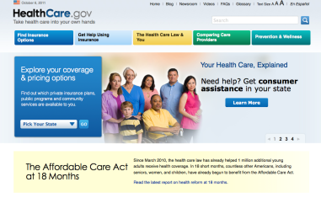


Learn More
http://www.healthcare.gov/
Social Networks
Indian Health Service – http://www.ihs.gov
Notes:
The health care law is a work in progress. But it has already made huge improvements that over time will touch every American family in some way.
To learn more about the law and any of the new benefits I mentioned, please go to healthcare.gov. You’ll find information and plenty of resources there that you can share with your friends and family. Also, please check the IHS website for frequent updates.
Thank you.

